Slide 1
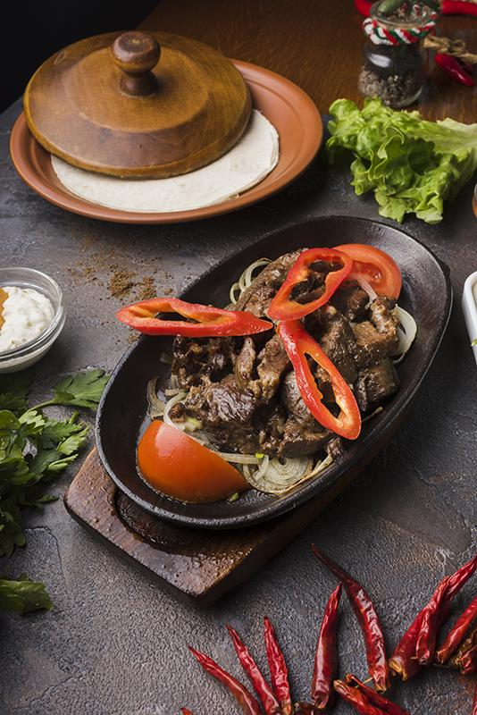
RESTAURANT ORDERS
Analyzing the data of fictitious restaurant serving international cuisine

Slide 2




What are the total number of items in the menu?
What are the different categories in the menu?
Give details of the cheapest item in the menu
Give details of the expensive item in the menu

Slide 3
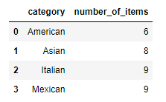
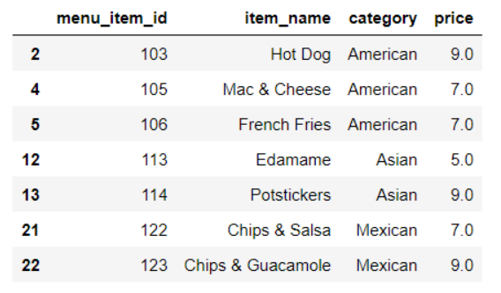
What are the number of food items in different categories?
Give details of items which are less than 10 dollars

Slide 4
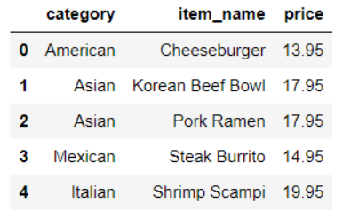
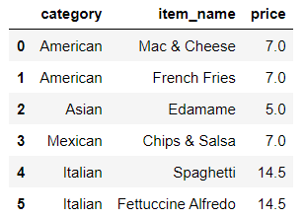
What is the most expensive item in each category?
What is the least expensive item in each category

Slide 5


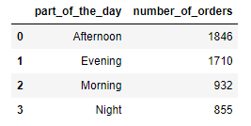
What is the average order size?(Number of items on average ordered during an order)
What is the average order value?(Average amount of money spent on each order)
What are the number of orders in different parts of the day?

Slide 6
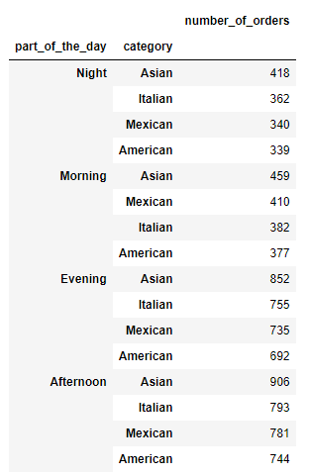
Which categories of food sell more during different parts of the day?
Insight-It can be seen that during any part of the day the Asian food was the most preferred international cuisine,american cuisine was the least preferred.

Slide 7
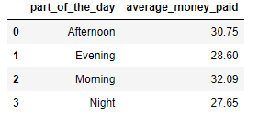
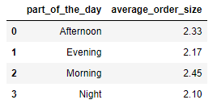
Do people spend more at night than in the morning?
Insight-It can be seen that people spend on average the most in the morning and the least at night
What is average order size during different parts of the day?(Number of items ordered on average)
Insight- People on average order on average more items in morning the most.

Slide 8
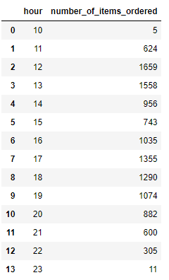
What is the peak hour for our business?(Number of items ordered during different hours)
Insight-Morning 10 am and night 11 am is the time when we don’t see many customers

Slide 9
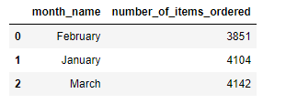


Number of items ordered at restaurant by month
Insight-Number of items ordered during were around 4000 items
What was the most and the least ordered item?
Insight-Hamburger was the most ordered item whereas the chicken Tacos was the least ordered items.

Slide 10

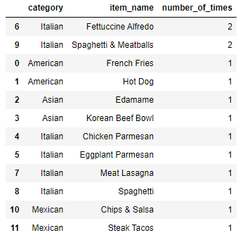
What do the highest spend order look like?
Insight- Person with order_id spend a whopping 192.15 dollars and ordered 12 different dishes.

Slide 11
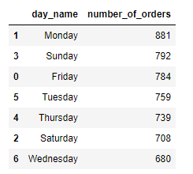
Number of orders in different days of the week?
Insight- Number of food orders were highest on monday while it was the least on wednesday.

Slide 12
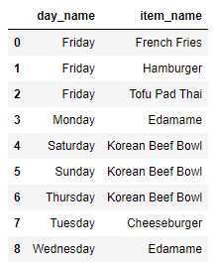
Most selling item on each day of the week
Insight-
a)French fries,hamburger and Tofu Pad Thai are the most popular item on Friday. b)Korean beef bowl is the most popular item on Saturday,Sunday and Thursday.
c) Edamame is the best selling food on Monday,Wednesday
d) On tuesday,Cheeseburger is the most selling food.

Slide 13
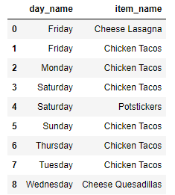
Least popular item on each day of the week
Insight-
a)Chicken Tacos was the least popular item on most days of the week.
b) Cheese Quesadillas, Cheese Lasagna,Potstickers were the least ordered items on Wednesday,Friday and Saturday respectively.

Slide 14
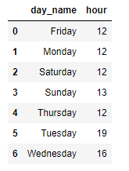
Peak hours during different parts of the week
Insight-
a)Noon 12 is the peak hour with most number of orders on Monday,Thursday,Friday,Saturday.
b) Afternoon 1pm was busiest hour on Sunday
c) Afternoon 4pm and Evening 7pm were rush hours on Tuesday and wednesday.

Slide 15
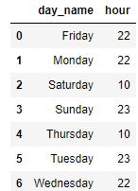
No rush hours on different parts of the week
Insight-
a)Night time on or after 10 pm is when the lower number of customer orders was observed.
b) On thursday and Saturday we see that morning 10am is the no rush hour.

Slide 16
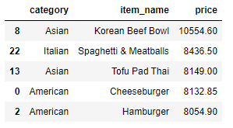
Top 5 products which makes most money
Insight-
Top 5 products are Korean beef bowl,Spaghetti and meatballs,Tofu Pad Thai,Cheeseburger,Hamburger(Two items are asian,two items are American and one is from Italian cuisine.

Slide 17
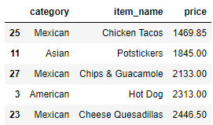
Bottom 5 products which make the least money for us
Insight-
Chicken tacos,Potstickers,Chips & Guacamole,Hot dog,Cheese Quesadillas made least money for the restaurant.

Slide 18
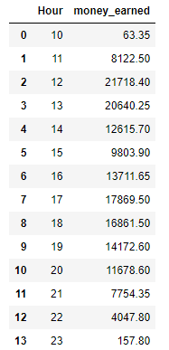
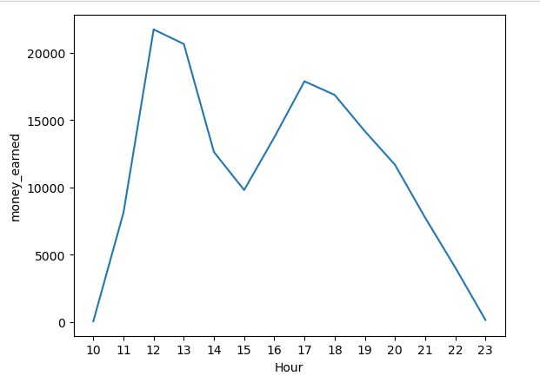
Money earned every hour
Insight-
Most of the restaurants business happens between 12pm to 3pm and between 4pm to 8pm.

Slide 19
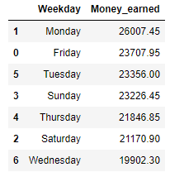
Money earned by day of the week
Insight-
Monday is the best day for restaurant.

Slide 20
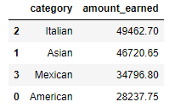
Which category of food we make more money in?
Insight-
Italian cuisine offered at our restaurant earned most money with asian cuisine a close second.

Slide 21
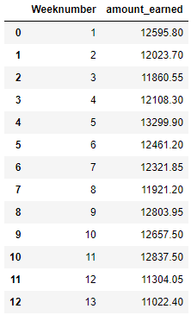
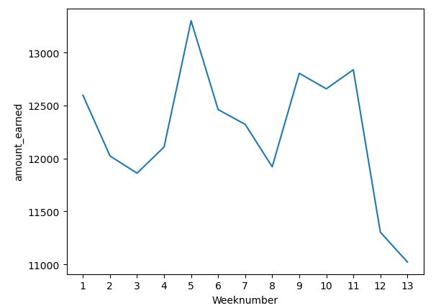
Which category of food we make more money in
Insight-
Weekly earnings of the restaurants fluctuated between 11000 and 13000.

